Slide 1
HDL Part IV
陳培殷
國立成功大學 資訊工程系

Slide 2
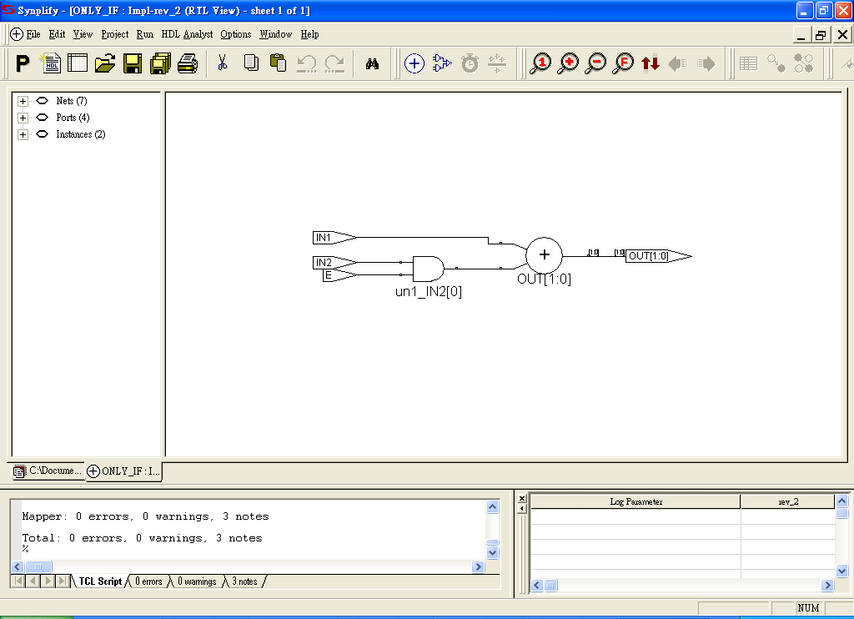
If-Else Statements (1/3)
The if statement is followed by a statement or block of statements enclosed by begin and end.
If the value of the expression is nonzero, the expression is true and the statement block that follows is executed. If the value of the expression is zero, the expression is false and the statement block following else is executed.
If..else statements can cause synthesis of latches.
If (expression)
begin
. . . statements . . .
end
[else
begin
. . . statements . . .
end]
module IF_ELSE(IN1 , IN2 , E , OUT);
input IN1, IN2, E;
output [1 : 0] OUT; reg [1 : 0]OUT;
always @(IN1 or IN2 or E)
begin
if(E == 1)
OUT = IN1 + IN2;
else
OUT = IN1; end
endmodule

Slide 3
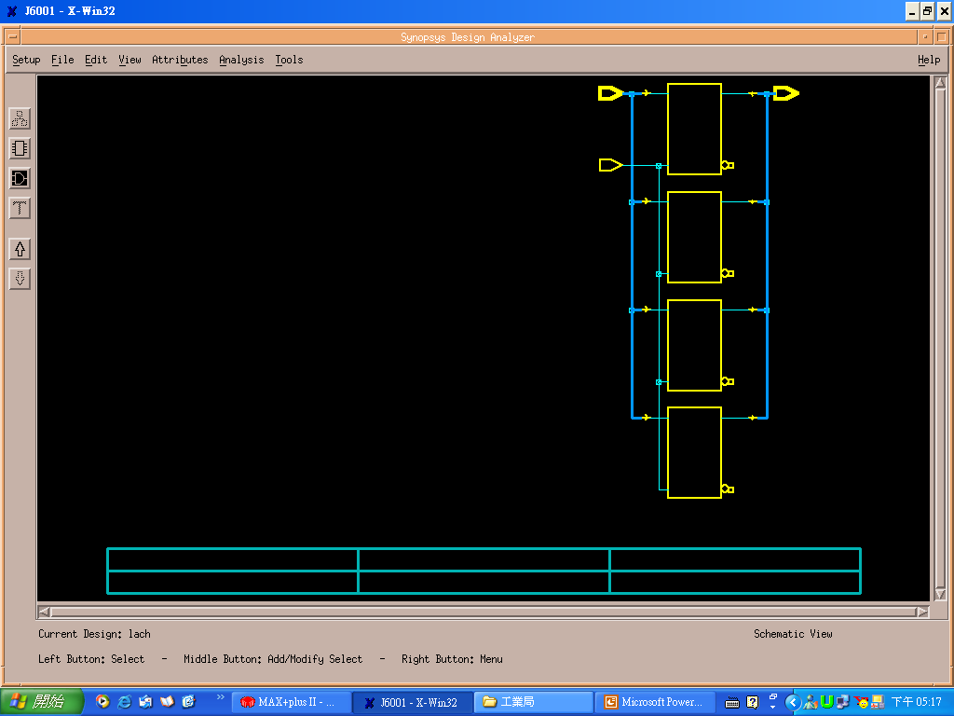
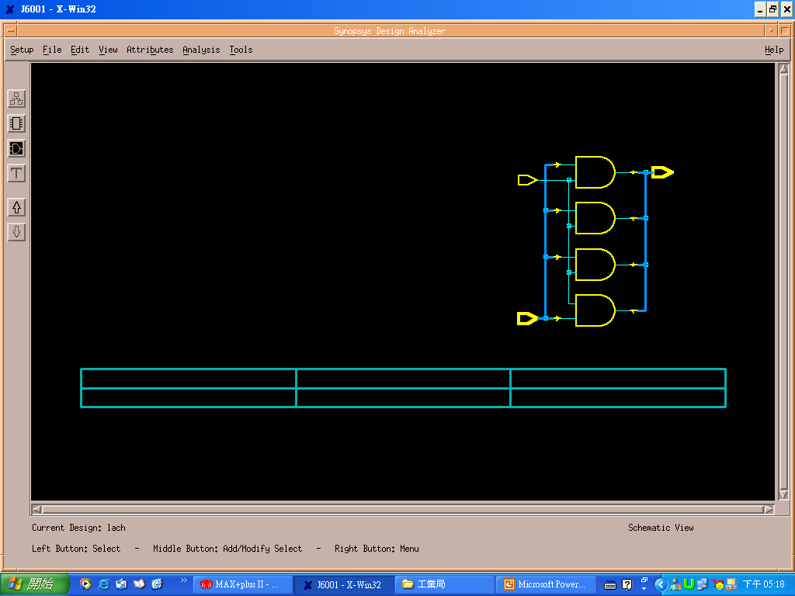
If-Else Statements (2/3)
Module Latch(In, Enable, Out);
input Enable;
Input [3:0] In;
output [3:0] Out;
always @(In or Enable)
begin
if(Enable)
Out=In;
else
Out=0;
end
endmodule
Watch for unintentional Latches
Module Latch(In, Enable, Out);
input Enable;
input [3:0] In;
output [3:0] Out;
always @(In or Enable)
begin
if(Enable)
Out=In;
end
endmodule
No latch inference
Always@ (In or Enable)
begin
Out=0;
if(Enable)
Out=In;
end // no latch
If Enable ==1
Out (new) = In
If Enable==0
Out (new) = Out (old)

Slide 4
If-Else Statements (3/3)
if-then-else statement implies priority-encoded MUXs
always @(sel or a or b or c or d)
if (sel[2] == 1’b1)
out = a; //sel=1XX
else if (sel[1] == 1’b1)
out = b; //sel=01X
else if (sel[0] == 1’b1)
out = c; //sel=001
else
out = d; //sel=000
d
0
c
1
sel
sel[0] = ‘1’
0
b
1
sel[1] = ‘1’
0
out
a
1
sel[2] = ‘1’

Slide 5
Case Statements (1/3)
case (expression)
case_item 1:
begin
. statements . .
end
case_item 2:
begin
. statements. .
end
. . . . .
default:
begin
. statements. .
end
endcase
The case statement consists of the keyword case, followed by an expression in parentheses, followed by one or more case items (and associated statements to be executed), followed by the keyword endcase. A case item consists of an expression (usually a simple constant) or a list of expressions separated by commas, followed by a colon (: ).
module FULL_CASE(IN , OUT);
input [1 : 0]IN;output [3 : 0] OUT;
reg [3 : 0]OUT;
always @(IN)
begin
case(IN)
2'b00: OUT = 4'b0001;
2'b01: OUT = 4'b0010;
2'b10: OUT = 4'b0100;
2'b11: OUT = 4'b1000;
endcase
end
endmodule
module FULL_CASE(IN , OUT);
input [1 : 0]IN;output [3 : 0] OUT;
reg [3 : 0]OUT;
always @(IN)
begin
case(IN)
2'b00: OUT = 4'b0001;
2'b01: OUT = 4'b0010;
2'b10: OUT = 4'b0100;
endcase // not full-case, latches are inferred
end
endmodule

Slide 6
Case Statements (2/3)
module FULL_CASE(IN , OUT);
input [1 : 0]IN; output [3 : 0] OUT;
reg [3 : 0]OUT;
always @(IN)
begin
case(IN)
2'b00: OUT = 4'b0001;
2'b01: OUT = 4'b0010;
2'b10: OUT = 4'b0100;
2'b11: OUT = 4'b1000;
endcase
end
endmodule
module FULL_CASE(IN , OUT);
input [1 : 0]IN; output [3 : 0] OUT;
reg [3 : 0]OUT;
always @(IN)
begin
case(IN)
2'b00: OUT = 4'b0001;
2'b01: OUT = 4'b0010;
2'b10: OUT = 4'b0100;
default: OUT = 4'b1000;
endcase
end
endmodule
It is always a good idea to use default-case-item in all conditions to
make sure no latch is inferred.

Slide 7
Case Statements (3/3)
Watch Out for Unintentional Latches!!
Completely specify all clauses for every case and if statement
Completely specify all output for every clause of each case or if statement
Failure to do so will cause latches or flip-flops to be synthesized
always @ (d)
begin
case (d)
2’b00: z = 1’b0;
2’b01: z = 1’b0;
2’b10: ;
endcase
end
Missing Case
Missing Outputs
d ==00 z = 0
d ==01 z=0
d ==10 z(new)=z(old)
d ==11 z(new)=z(old)

Slide 8
For Loop Statements (1/2)
The for loop repeatedly executes a single statement or block of statements. The repetitions are performed over a range determined by the range expressions assigned to an index. Two range expressions appear in each for loop: low_range and high_range. In the syntax lines that follow, high_range is greater than or equal to low_range. HDL Compiler recognizes incrementing as well as decrementing loops. The statement to be duplicated is surrounded by begin and end statements.
for (index = low_range; index < high_range; index = index + step)
for (index = high_range; index > low_range; index = index - step)
for (index = low_range; index <= high_range; index = index + step)
for (index = high_range; index >= low_range; index = index - step)
for (i = 0; i <= 31; i = i +1)
begin
s[i] = a[i] ^ b[I] ^ carry;
carry = (a[i] & b[i]) | (a[i] & carry) | (b[i] & carry);
end
For statement: unrolling the logic

Slide 9
For Loop Statements (2/2)
for loop are “unrolled”, and then synthesized.
integer i;
always @(a r b)
begin
for (i = 0; i < 6; i = i+1)
example[i] <= a[i] & b[5-i];
end
a[0]
example[0]
b[5]
a[1]
example[1]
b[4]
a[2]
Verilog for loop
example[2]
b[3]
a[3]
example[3]
example [0] <= a[0] and b[5];
example [1] <= a[1] and b[4];
example [2] <= a[2] and b[3];
example [3] <= a[3] and b[2];
example [4] <= a[4] and b[1];
example [5] <= a[5] and b[0];
b[2]
a[4]
example[4]
b[1]
a[5]
example[5]
b[0]
for loop synthesized to gates
for loop unrolled

Slide 10
Always Block (1/3)
An always block can imply latches or flip-flops, or it can specify purely
combinational logic. An always block can contain logic triggered in
response to a change in a level (asynchronous triggers) or the rising or falling edge of a signal (synchronous triggers).
The syntax of an always block is
always @ (event-expression )
begin
. . . statements . . .
end (combinational circuit)
Completely specify sensitivity lists to avoid error
Asynchronous triggers
x is recalculated as soon as
any input (a or b or c) has a
level transition (0 to 1 or 1 to 0).
always@ (a or b or c)
begin
x=a | b | c;
end

Slide 11
Always Block (2/3)
always @ ( [posedge or negedge] event)
begin
. . . statements . . .
end (sequential circuit)
rising
edge
(posedge)
falling
edge
(negedge)
Rising edge or positive edge (posedge)
Falling edge or negative edge (negedge)
Synchronous triggers
x is recalculated as soon as
c changes from 0 to 1 or
d changes from 1 to 0.
always@ (posedge c or negedge d)
begin
x=a +b;
end
storage unit

Slide 12
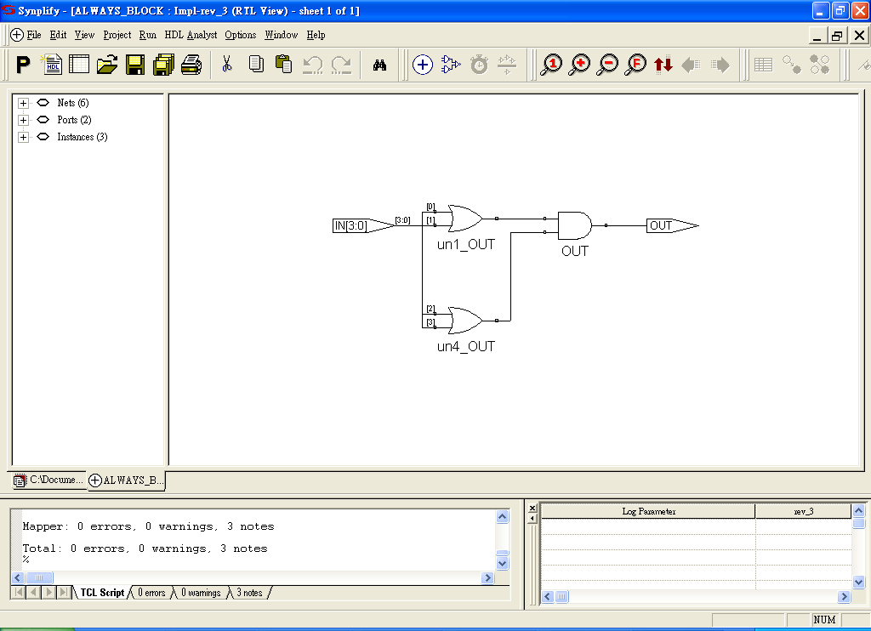
Always Block (3/3)
module ALWAYS_BLOCK(IN , OUT);
input [3 : 0]IN; output OUT; reg OUT;
always @(IN)
begin
OUT = (IN[0] | IN[1]) & (IN[2] | IN[3]);
end
endmodule
module D_FF(Clk, D, Q);
input Clk, D;
output Q;
Reg Q;
always @(posedge Clk)
begin
Q=D;
end
endmodule
D Q
Clk
At every positive edge of signal Clk,
Q is set as D.

Slide 13
Function
function [range] name_of_function;
function declaration
statement
endfunction
Begin with function and end with endfunction
[Range] defines the width of the return value of the function (default is 1 bit) Contain one or more statements (enclosed inside a begin-end pair)
You can call function in a continuous assignment, always block or other functions
Function declaration:
Input declaration: specify the input signals for a function
Output: The output from a function is assigned to the function name.
Use concatenation operation to bundle several values for multi-outputs

Slide 14
Function Statements (1/2)
Procedure assignments are assignment statements used inside a function.
(It is similar to C language, Note: it cannot be used in module)
They are similar to the continuous assignments, except that the left side of
a procedural assignment can contain only reg and integer variables.
always @(A or B)
begin
C1 = Fn1(A , B);
end
always @(A or B)
begin
C2 = Fn1(A , B);
end
always @(A or B)
begin
C3 = A + B;
end
assign C4 = A + B;
endmodule
module FUN_STATE(A , B , C1 , C2 , C3 , C4 , C5);
input [3 : 0]A; input [3 : 0]B;
output [6 : 0]C1; //0
output [2 : 0]C2; //discard
output [4 : 0]C3; //always
output [4 : 0]C4; //assign
reg [6 : 0]C1; reg [2 : 0]C2;
reg [4 : 0]C3; reg [4 : 0]C4;
function [4 : 0]Fn1;
input [3 : 0]A; input [3 : 0]B;
Fn1 = A + B; // like C
endfunction
Three different ways to implement addition.

Slide 15
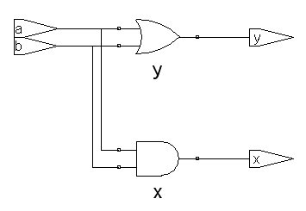
Function Statements (2/2)
module test_n(a, b, x, y);
input a, b;
output x, y;
assign x=a & b;
assign y=a | b;
endmodule
module test_n(a, b, x, y);
input a, b; output x, y;
reg x, y;
function Fn1;
input a, b;
Fn1 = a & b;
/* begin-end is required
for more statements */
endfunction
function Fn2;
input a, b;
Fn2 = a | b;
endfunction
always @(a or b)
begin
x = Fn1(a, b);
y = Fn2(a, b);
end
endmodule
module test_n(a, b, x, y);
input a, b;
output x, y;
reg x, y;
always @(a or b)
begin
x = a & b;
y = a | b;
end
endmodule
C language ??
x = a&b;
y = a | b;
i=Fn1(a, b);
j=Fn1(a, b);
k=Fn1(a, b);

